Slide 1


Sign Language Recognition with Machine Learning

Slide 2
ASL
13.1%
PROBLEM STATEMENT
WHY?
1%
5%
Deaf or Mute
ASL
466 Million
70 Million
Deaf or Mute
86.9%

Slide 3

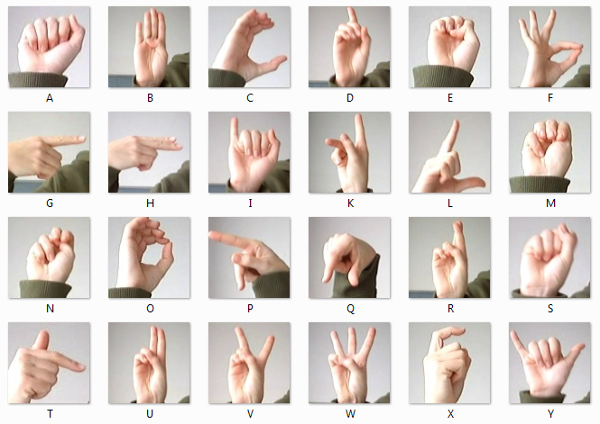
SIGN LANGUAGE MNIST DATASET
Inspired by the Fashion-MNIST 2 and the machine learning pipeline for gestures by Sreehari 4.

Slide 4
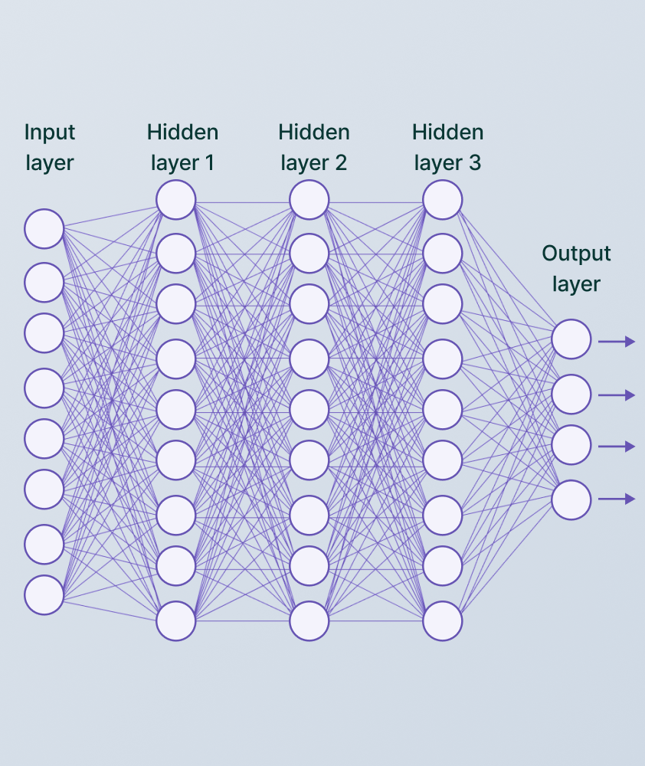
CONVOLUTION NEURAL NETWORKS
3 LAYER CNN MODEL

Slide 5
import pandas as pd
import numpy as np
import seaborn as sns
import random
from sklearn.model_selection import
train_test_split
import tensorflow as tf
import tensorflow.keras
from tensorflow.keras.preprocessing.image
import ImageDataGenerator
from tensorflow.keras.optimizers import Adam
from tensorflow.keras.callbacks import ModelCheckpoint, EarlyStopping, ReduceLROnPlateau
from tensorflow.keras.models import Sequential
from tensorflow.keras.layers import Conv2D, BatchNormalization, MaxPool2D, Flatten, Dense, Dropout
import warnings
CODE

Slide 6
df_train = pd.read_csv('sign_mnist_train[1].csv’)
from sklearn.model_selection import
train_test_split
df_test = pd.read_csv('sign_mnist_test[1].csv’)
y_train = df_train['label’]
df_train.drop(['label'], axis=1, inplace=True)
y_test = df_test['label’]
df_test.drop(['label'], axis=1, inplace=True)
X_train = df_train.values.reshape(df_train.shape[0], size, size, channels)
X_test = df_test.values.reshape(df_test.shape[0], size, size, channels)
CODE

Slide 7
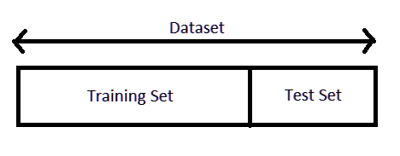
CODE

Slide 8
X_train = datagen.flow(X_train, y_train, batch_size=batch)
X_test = datagenRescale.flow(X_test, y_test)
import numpy as np
import matplotlib.pyplot as plt
from PIL import Image
# storing image pathfname = r'amer_sign3[1].png’
# opening image using pilimage = Image.open(fname).convert("L")
# mapping image to gray scale
plt.imshow(image, cmap='gray’)
plt.show()
for i in range(9):
plt.subplot(3, 3, i+1)
for X_batch, Y_batch in X_train:
image = X_batch[i]
plt.xlabel(alphabet[Y_batch[i]])
Break
plt.show()
CODE

Slide 9
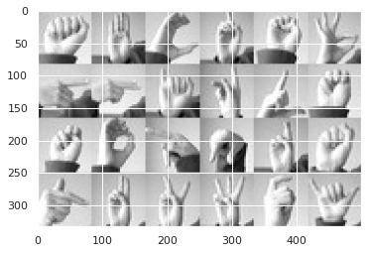
CODE

Slide 10
datagen =
ImageDataGenerator(rescale=1./255,
zoom_range=0.2,
width_shift_range=.2,
height_shift_range=.2,
rotation_range=30,
brightness_range=[0.8, 1.2],
horizontal_flip=True)
datagenRescale = ImageDataGenerator(rescale=1./2550)
X_train = datagen.flow(X_train, y_train, batch_size=batch)
X_test = datagenRescale.flow(X_test, y_test)
CODE

Slide 11


CONVOLUTION LAYER

Slide 12
CONVOLUTION LAYER

Slide 13
CONVOLUTION LAYER

Slide 14
CONVOLUTION LAYER

Slide 15
CONVOLUTION LAYER

Slide 16
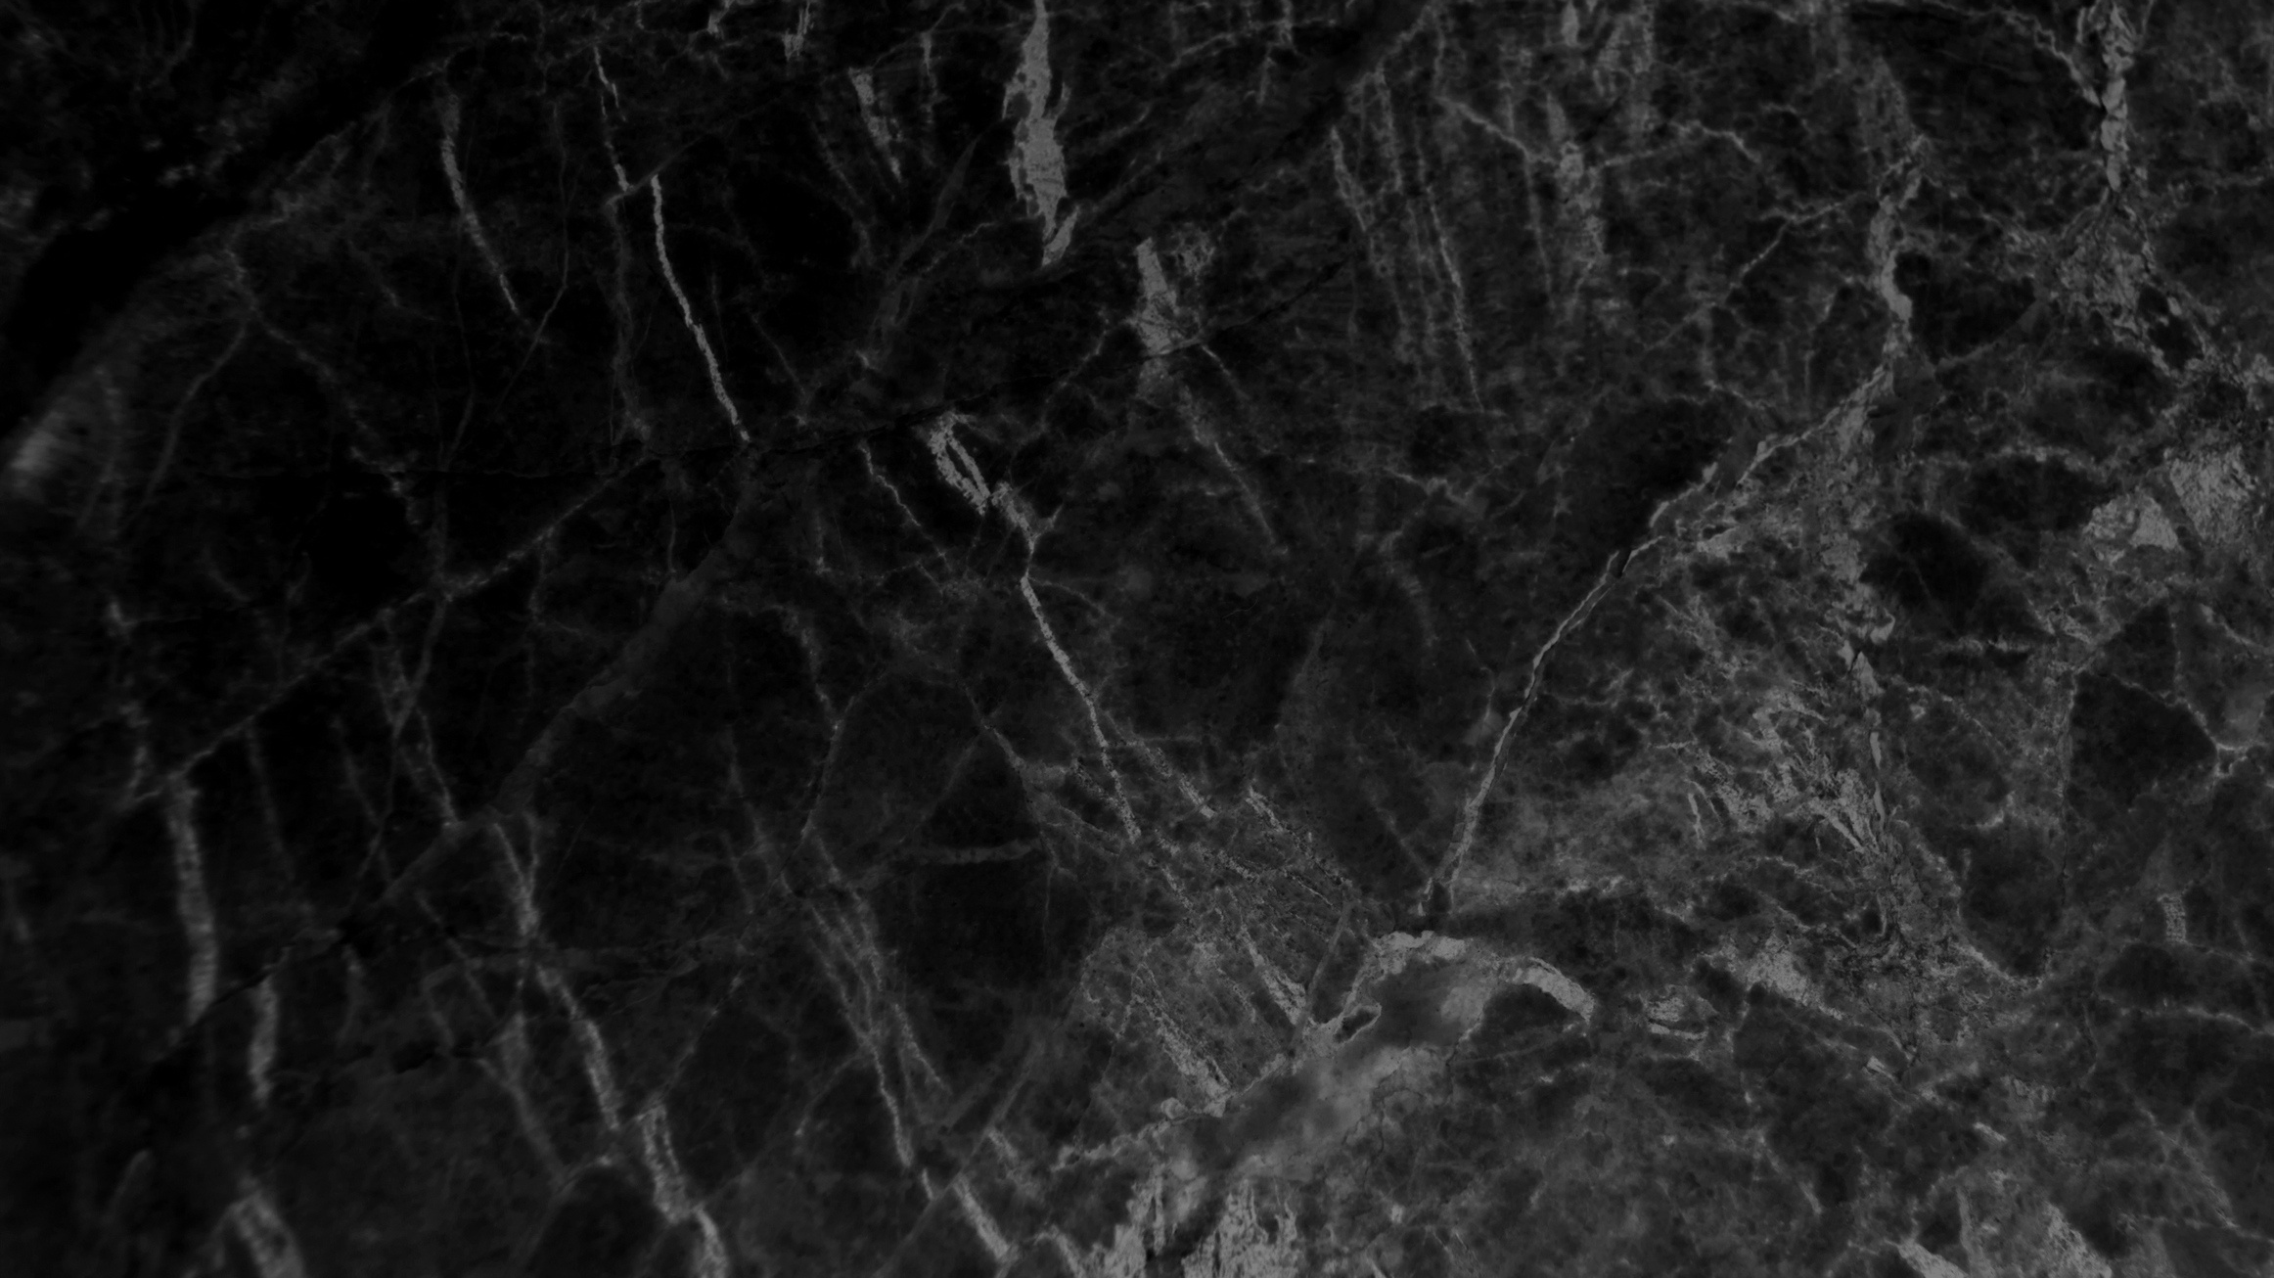
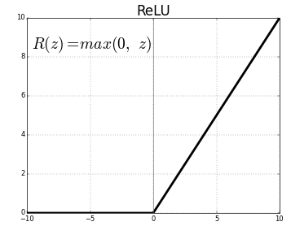
ACTIVATION FUNCTION LAYER
RECTIFIED LINEAR UNIT

Slide 17
Model = Sequential([Conv2D(filters=32, kernel_size=(3,3), activation="relu",
input_shape=(size,size,channels)),
MaxPool2D(2,2, padding='same’),
Dropout(0.2),
Conv2D(filters=128, kernel_size=(3,3), activation="relu"),
MaxPool2D(2,2, padding='same’),
Dropout(0.2),
Conv2D(filters=512, kernel_size=(3,3), activation="relu"),
MaxPool2D(2,2, padding='same’),
Dropout(0.2),
Flatten(),
Dense(units=4096, activation="relu"),
Dropout(0.2),
Dense(units=1024, activation="relu"),
Dropout(0.2),
Dense(units=256, activation="relu"),
Dropout(0.2),
Dense(units=25, activation="softmax"),])
Model.compile(optimizer='adam', loss="sparse_categorical_crossentropy", metrics=["accuracy"])
Model.summary()
CODE

Slide 18
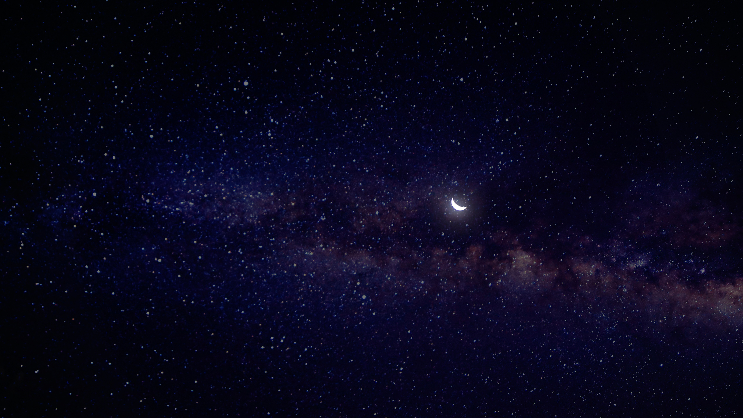
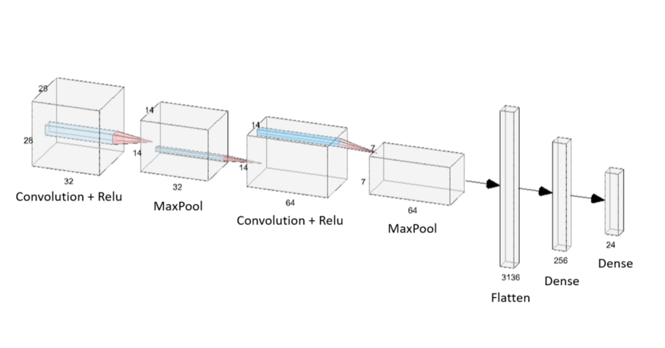

Slide 19

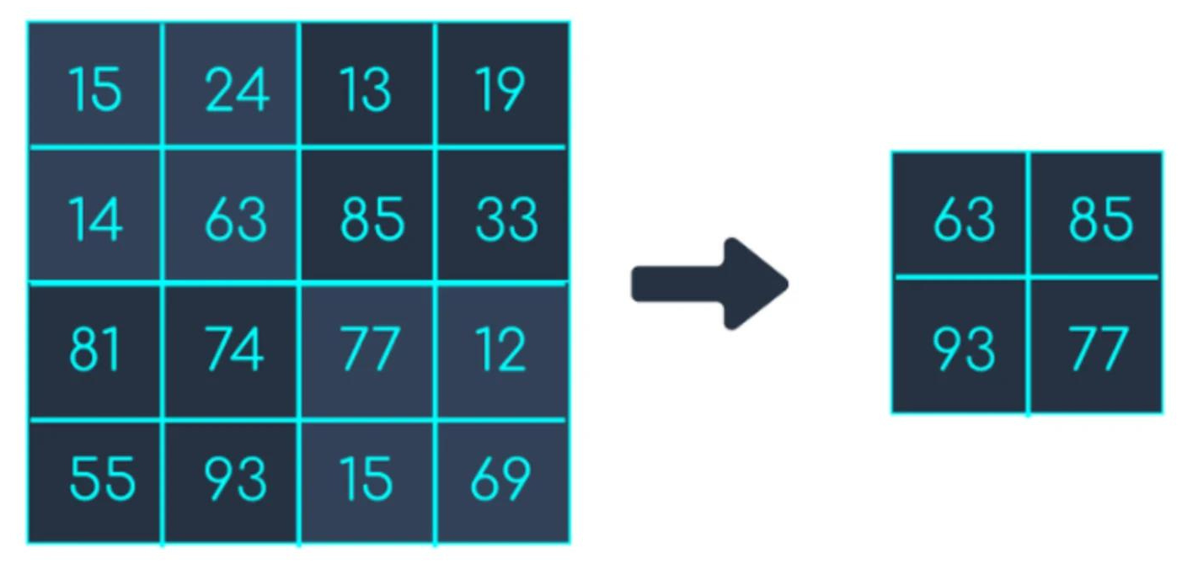
MAX POOLING LAYER

Slide 20
acc = history.history['accuracy’]
val_acc = history.history['val_accuracy’]
loss = history.history['loss’]
val_loss = history.history['val_loss’]
epochs_range = range(len(acc))
plt.figure(figsize=(15, 15))
plt.subplot(2, 2, 1)
plt.plot(epochs_range, acc, label='Training Accuracy’)
plt.plot(epochs_range, val_acc, label='Validation Accuracy’)
plt.legend(loc='lower right’)
plt.title('Training and Validation Accuracy’)
plt.subplot(2, 2, 2)
plt.plot(epochs_range, loss, label='Training Loss’)
plt.plot(epochs_range, val_loss, label='Validation Loss’)
plt.legend(loc='upper right’)
plt.title('Training and Validation Loss’)
plt.show()
CODE

Slide 21
score = Model.evaluate(X_test)
print('Test loss:', score[0])
print('Test accuracy:', score[1])
CODE
plt.figure(figsize=(15,15))
for i in range(9):
plt.subplot(3,3,i+1) plt.imshow(X_test[i],cmap='gray’)
plt.ylabel(f"True: {alphabet[y_test[i]]}") plt.xlabel(f"Predicted: {alphabet[y_pred[i]]}")
plt.show(

Slide 22
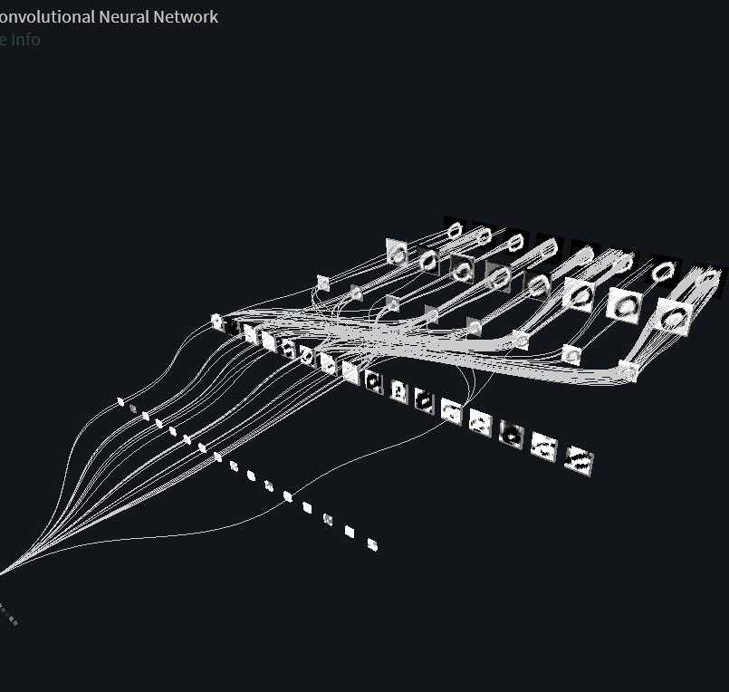
99.6 %
ACCURACY

Slide 23

Thank you!

